Slide 1

cv
Literature Review of Breast cancer Detection using Machine Learning Techniques
Team Members
1. Shalini Singh (1DS19CS146)
2. Kota V Vishnu (1DS19CS723)
3. Reena Jasmine Edwin (1DS19CS738)
4. S Sai Brinda (1DS19CS741)
Under the Guidance of
Mrs Annapoorna B.R
Assistant Professor
Dept of Computer Science and Engineering
Department of Computer Science & Engineering, DSCE

Slide 2
BATCH 32 Team Members Contribution
Shalini Singh (1DS19CS146) 8 Papers | Kota V Vishnu (1DS19CS723) 8 Papers
Reena Jasmine Edwin (1DS19CS738) 8 Papers | S Sai Brinda (1DS19CS741) 8 Papers

Slide 3
Details about Base Paper
Title:
An Automatic Detection of Breast Cancer Diagnosis and Prognosis Based on Machine Learning Using Ensemble of Classifiers.
Authors:
Usman Naseem , Junaid Rashid , Liaqat Ali , Jungeun Kim , Qazi Emad Ul Haq , Mazar Javed Awan and Muhammad Imran.
Published in: IEEE Access ( Volume: 10)
Date of Publication: 12 May 2022
Publisher: IEEE
DOI: 10.1109/ACCESS.2022.3174599

Slide 4
Abstarct
The goal of this research is to present a method for automated diagnosis and prognosis of breast cancer utilising an ensemble of classifiers.
The four classifiers used in ensemble method are SVM, LR, NB, and DT.
Showing and contrasting several ensemble models and other tested ML-based model variations with and without the use of up-sampling on two benchmark datasets.
To demonstrate that the ensemble technique beat other cutting-edge methods and attained a greater accuracy of 98.83%.

Slide 5
Author’s Contributions
An ensemble of machine learning-based methods for breast cancer diagnosis and prognosis using an ensemble of machine learning classifiers.
A comprehensive comparison of the performance of various machine learning and ensemble machine learning-based classifiers.
Evaluation of different sampling methods to address the class imbalance issue in the datasets.
Demonstration that the proposed method outperforms various state-of-the-art methods for the detection of breast cancer.
Analysis with and without sampling techniques is performed.

Slide 6

Dataset Description
The Breast cancer Wisconsin (Diagnosis)1 and Breast cancer Wisconsin (Prognosis)2 databases are used in this study.
Wisconsin Breast Cancer (Diagnosis) contains 569 instances and 32 attributes (an ID and a target variable).
Wisconsin Breast Cancer (Prognosis) contains 198 instances and 34 attributes (containing an ID and a target variable).

Slide 7
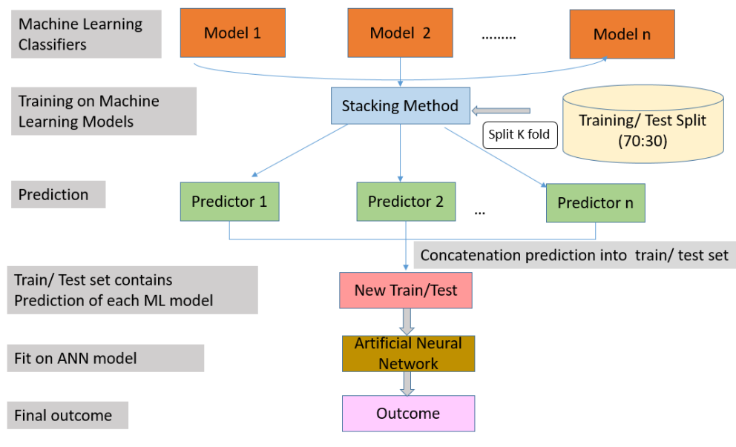
Methodology

Slide 8
The steps of the proposed model are:
1) Use of Machine learning based classifiers on a training dataset.
2) In the second step, the K-fold method retrieves the most common outcome from these classifiers.
3) In third step, the results from machine learning classifiers are concatenated.
4) New training dataset streamlined as a result.
5) In this step, input the new dataset into the default ANN.
6) Result and evaluation of outputs.
This architecture is made up of four different machine learning models. They are then stacked and trained as an ensemble. The ANN model is used for the outcome after training.

Slide 9
Machine Learning Algorithms Used
1) SUPPORT VECTOR MACHINE (SVM)
2) LOGISTIC REGRESSION (LR)
3) NAIVE BAYES (NB)
4) DECISION TREE (DT)
5) ARTIFICIAL NEURAL NETWORK (ANN)

Slide 10
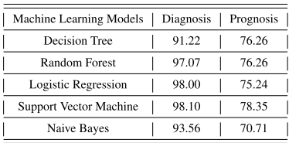
EVALUATION METRIC –
In this study Accuracy is used as evaluation metric to compare the performance of the model.
Accuracy :
The percentage of accurate predictions for the test results is known as accuracy.
Accuracy = Number of correct predictions /All samples
Results and Observations-
1) SVM outperforms all ML-based classifiers on both diagnosis BC with 98.10% accuracy and prognosis BC dataset with 78.35% accuracy. In contrast, the worst classifier on the diagnosis dataset is DT with 91.22% accuracy and NB on the prognosis dataset with 70.71%.

Slide 11

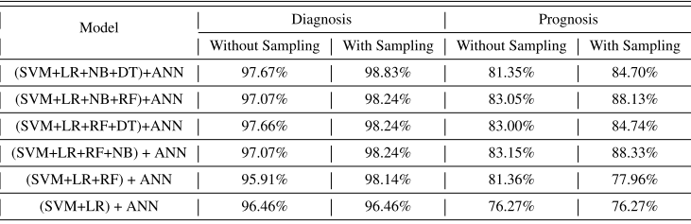
2) For DL-based classifiers, ANN performs well on both datasets, with 98.24% accuracy on the diagnosis dataset and 90.22% accuracy on the prognosis dataset compared to DNN.
3) The best ensemble model is the ensemble of (SVM + LR + NB + DT) in both cases (without 97.67% and with upsampling 98.83%). In contrast, the worst-performing combination is (SVM+LR+RF) in both cases (95.91% for without sampling and 98.14% for upsampling) on the diagnosis dataset.
For prognosis, the best ensemble model combines (SVM+LR+RF+NB) in both cases (without 83.15% and with upsampling 88.33%). In contrast, the worst-performing combination is (SVM+LR) in both cases (76.27% for without and 76.27% with up-sampling) on prognosis.

Slide 12
Conclusion
SVM outperforms both datasets compared to all ML classifiers and ANN from DL classifiers when used individually.
For the ensembling method, (SVM + LR + NB + DT) performs well without and with upsampling on the diagnosis dataset, whereas (SVM+LR+RF+NB) outperforms all other combinations on the prognosis dataset when ANN is used as a final layer.
Future Scope
Authors intend to apply more advanced models for the automatic detection of Breast Cancer.

Slide 13
Literature Survey Table
S.No | Title | Feature extraction Techniques | ML Algorithms | Performance Metrics | Conclusion and Challenges (if any) | DOI Link
1 | Naïve Bayes Model Based Improved K-Nearest Neighbor Classifier for Breast Cancer Prediction | Data Pre-Processing- Data cleaning is done so as to remove outliers and missing values. | KNN, Naïve Bayes and Naïve Bayes improved K-Nearest Neighbor (NBKNN) | KNN- Accuracy:96.7 Naïve Bayes- Accuracy:95.9 NBKNN- Accuracy:97.5 | NBKNN model works better than traditional classifiers used in the research. Different bio-inspired techniques like Ant Colony Optimization (ACO), Particle Swarm Optimization (PSO) can be used to optimize the result. | https://doi.org/10.1007/978-981-15-0108-1_1

Slide 14
2 | Decision Tree Model Based Gene Selection and Classification for Breast Cancer Risk Prediction | Feature selection techniques(Gene selection models)- The fisher-score based filter method and the connate feature selection ability of the C5.0 algorithm | Regression Logistic (LR), C5.0 Decision Tree, Support Vector Machine (SVM) and Artificial Neural Network (ANN) | Prediction without Gene selection- Dimensions: Number of selected genes=24481 Accuracy: ANN exhibited a higher accuracy rate of 86.99%, while C5.0 shows the lowest accuracy rate of 79.01%. | Model trained with Gene Selection method applied performs best in dimentionality reduction. The authors intend to test the effectiveness of the suggested strategy using new microarray datasets that have varied qualities in terms of the number of genes, samples, and classes. | https://doi.org/10.1007/978-3-030-45183-7_12

Slide 15
 |  |  |  | Prediction with Gene selection- Dimensions: Number of selected genes=5 Accuracy: All generated shrinkage models produced high classification accuracy that exceeds 80%
3 | Parallel Implementation of kNN Algorithm for Breast Cancer Detection | kNN algorithm is parallelized using MPI and CUDA frameworks. | Serial and Parallel computation of kNN algorithm | The execution time with parallel kNN was nearly half the time taken for sequential execution and execution of kNN using CUDA was further reduced | Parallel Execution of Model built gives best performace. | https://doi.org/10.1007/978-981-15-5788-0_46

Slide 16
4) | Computer-aided Diagnosis System for Breast Cancer Using RF Classifier | Preprocessing -Image is preprocessed using Gussian filter and Adaptive histogram equalization method Image is segmented for extracting malignant tumors GLCM is used for feature extraction Fcbf for feature selection | CAD System using Random Forest | This method has achieved accuracy to the extent of 97.32%, sensitivity as high as 97.45%, specificity of about 98.13% and ROC with AUC is 97.28%. The ROC (Receiver operating characteristics) | Result shows that RF classifier provides good classification accuracy by reducing the FPs and FNs and it also depends upon the optimization of feature selection | https://doi.org/10.1109/WiSPNET.2017
1 | Classification of Microcalcifications in Mammograms using 2D Discrete Wavelet Transform and Random Forest |  | mammogram images were first subjected to a two-dimensional discrete wavelet transform for improving contrast

Slide 17
5) | A Breast Cancer Diagnosis Method Based on VIM Feature Selection and Hierarchical Clustering Random Forest Algorithm | By Bootstrap method we select subsets. VIM method is used to calculate the importance of all the features and rank them according to their importance by minimum Gini Index | Hierarchical Clustering Random Forest Algorithm | 97.05% accuracy on the WDBC dataset and 97.76% accuracy on the WBC dataset. | more heuristic algorithms to optimize the relevant parameters to make the method more intelligent Can be used | https://doi.org/10.1109/ACCESS.2021.

Slide 18
6) | Breast Cancer Risk Prediction using XGBoost and Random Forest Algorithm | Trimmed mean and mode had been used for data preprocessing. Trimmed Mean is the removal of a small fixed percentage of the largest and smallest values before calculating the average | Random Forest, Extreme Gradient Boosting (XGBoost) | 74.73% accuracy of Random forest and 73.63% accuracy for XGBoost | The result of this model Was better than others One of Limitation Was number Of features And samples were less | https://doi.org/10.1109/ICCCNT49239

Slide 19
7) | A CAD Tool for Breast Cancer Prediction using Naive Bayes Classifier | Data Preprocessing is done by grouping the data into DISCRETIZE and RESAMPLE Filters. The DISCRETIZE Filters deals with scans which have similar contours. The RESAMPLE Filter deals with scans containing dissimilar features. | Naive Bayes | 73.75 % accuracy of Naive Bayes Supervised Attribute DISCRETIZE filter has accuracy of 81% RESAMPLE Filter has accuracy of 85% | More supervised learning techniques could have been used to improve the model results | https://doi.org/10.1109/ESCI48226.2020.9167568

Slide 20
8) | Breast Cancer Detection using Deep Learning | Data Preprocessing is done by image resizing and image conversion. The dataset is split into 70% training and 30% testing data with the split being automized. | VGG16 and Resnet 50 | VGG16 has an accuracy score of 94% Resnet 50 has an accuracy score of 91% | Whilst Resnet and VGG16 are displaying good accuracy and precision scores, an abnormal scan is severely hampering the results.Therefore the technique to scan should be improved. | https://doi.org/10.1109/EnCon.2019.8861256

Slide 21
9) | Cancer Classification using Naive Bayes Algorithm | Data Preprocessing is done by image resizing and image conversion. The dataset is split into 70% training and 30% testing data with the split being automized. | Naive Bayes | Naive Bayes shows an accuracy of 98% | The proposed work presents an efficient technique for normalization to determine the inefficient value in the classification which deserves to be zero. The Naïve Bayes algorithm is used based on Gaussian distribution for predicting cancer | https://doi.org/10.1109/EnCon.2019.8861256

Slide 22
10) | Breast Cancer Detection using SVM Classifier with Grid Search Technique | Seaborn is a statistical plotting library built on top of matplotlib which is designed to work well with pandas. Dataframes are in matrix form so it is better to draw heat map. The dataset is split into 70% training and 30% testing data with the split being automized. | SVM without Grid Search, SVM with Grid Search | Without Grid Search: Avg Recall:38% Avg Precision:61% With Grid Search: Avg Recall:95% AvgPrecision:95% | using grid search with Breast cancer dataset gives much better result than using normal SVM model. The experiment results are encouraging. It can be seen that right value of parameters for C and gamma is critical for a given amount of data. | Doi: 10.5120/ijca2019919157

Slide 23
11) | Breast Cancer Diagnosis Using Machine Learning Techniques | Pre-processing: One hot Encoding Feature and Target Identification The given dataset is divided into 90% training and 10% testing sets based on the 10-fold cross validation strategy | CART, SVM, Gaussian Naive Bayes, K-Nearest Neighbour | CART: Time tobuild:0.06sec Accuracy:95.1% SVM: Time tobuild:0.07sec Accuracy:97.13% Gaussian Naive Bayes: Time tobuild:0.055sec Accuracy:96% KNN: Time tobuild:0.01sec Accuracy:95.3% | SVM outperforms other algorithms in efficiency and with accuracy of 97.13% | doi:10.1007/978-981- 15-0108-1-1

Slide 24
12) | Performance Evaluation of Machine Learning Methods for Breast Cancer Prediction | There are two datasets used in this study. firstly collect the raw data of the BCCD dataset and raw data of WBCD dataset. Then preprocess the raw data of WBCD dataset. Pre-processing: One hot Encoding, Data Cleaning. Feature and Target Identification 70% as the training data and 30% as the test data based on the 50-fold cross validation strategy | DT, SVM, RF,LR, NN | BCCD Data: Accuracy: (DT) 0.686 (SVM)0.714 (RF)0.743 (LR)0.657 (NN)0.600 F-measure metric (DT)0.717 (SVM)0.762 (RF)0.780 (LR)0.616 (NN)0.570 WBCD Data: Accuracy: (DT)0.961 (SVM)0.951 (RF)0.961 (LR)0.937 (NN)0.956 F-measure metric (DT)0.941 (SVM)0.934 (RF)0.955 (LR)0.938 (NN)0.945 | this study only collects the data of 10 attributes in this experiment. The limited raw data has an effect on the accuracy of results. RF has the best performance on classification accuracy in comparison with other four models. In addition, the RF also can be combined with other data mining technologies to obtain more accurate and efficient results in the future work. | Doi: 10.11648/j.acm.20180704.15

Slide 25
cv
Thank You
Department of Computer Science & Engineering, DSCE

